Slide 1
Real-Time Volumetric Cloud Rendering with Ray-Marching Technique
Victor Shu, Yun Jiang

Slide 2
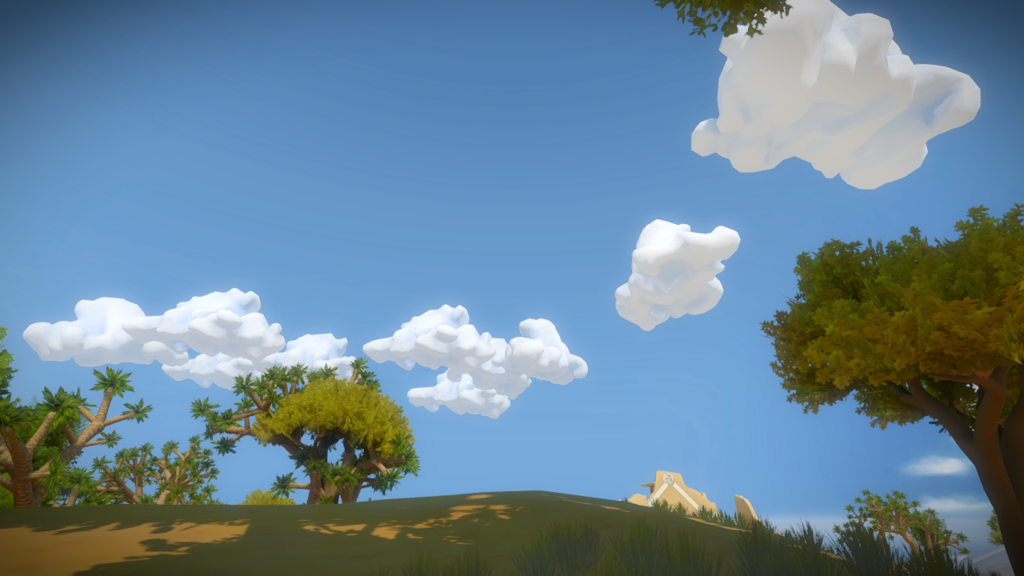
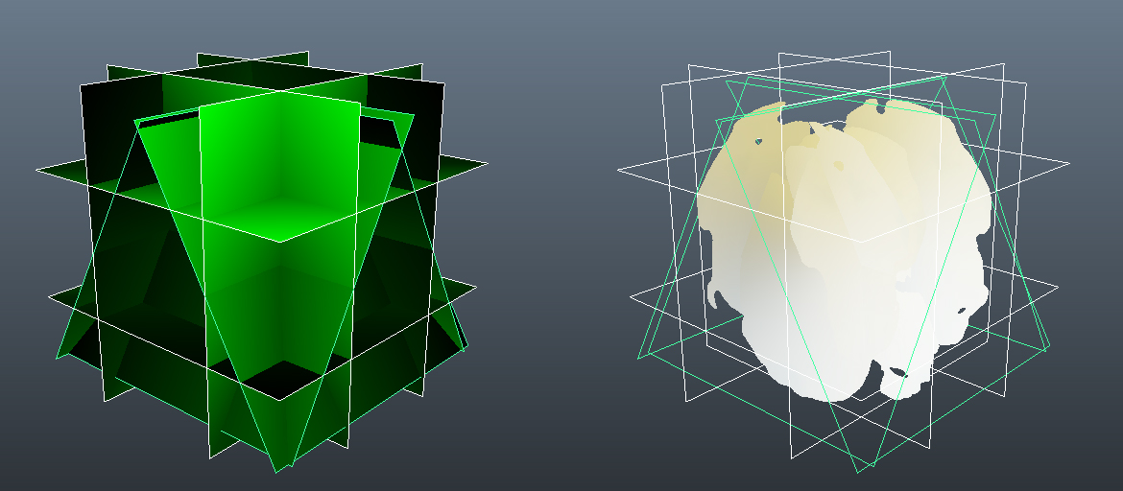
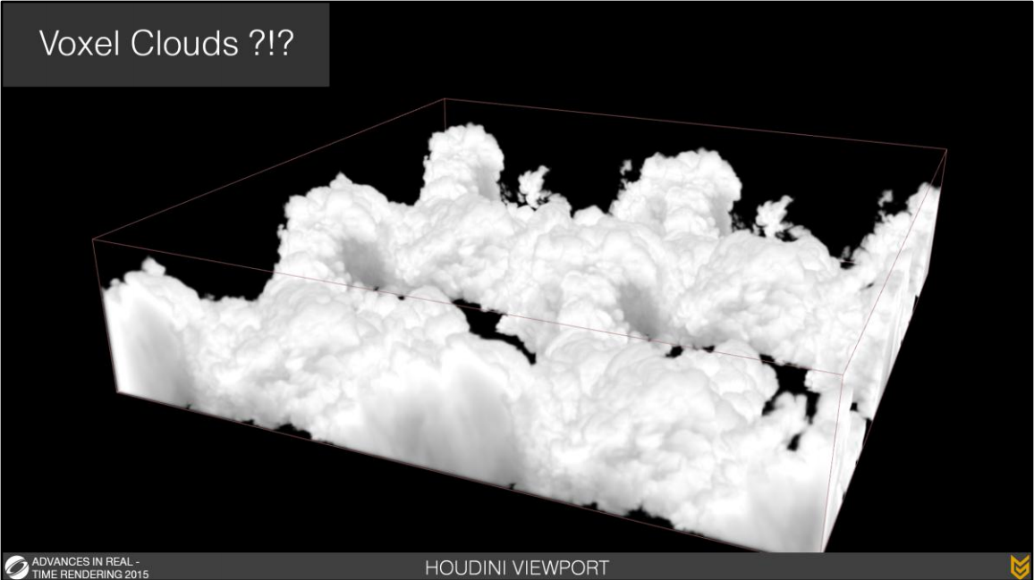
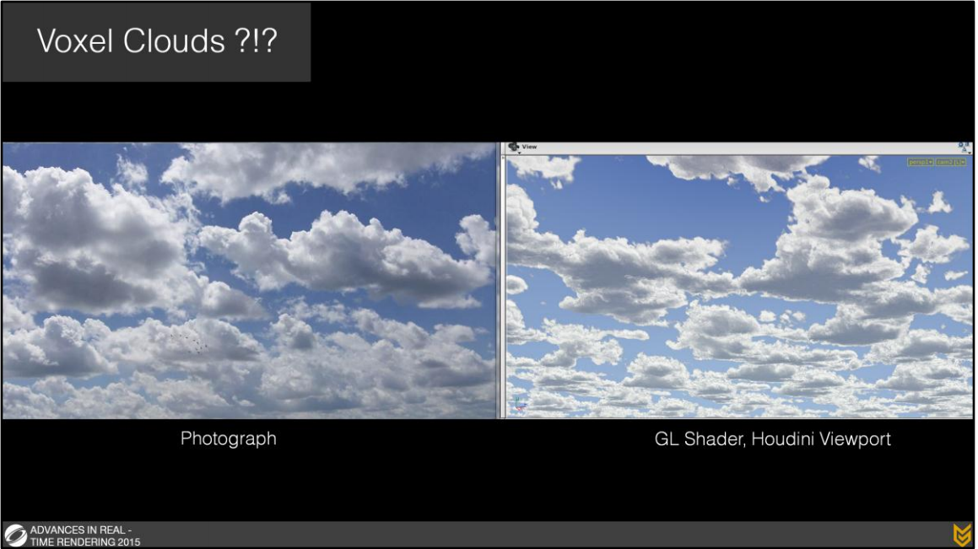
Introduction
Geometry Planes – Unrealistic, Hard to Shade ^{[WITNESS]}
Voxel Clouds – Poor Performance ^{[GUERRILLA]}

Slide 3

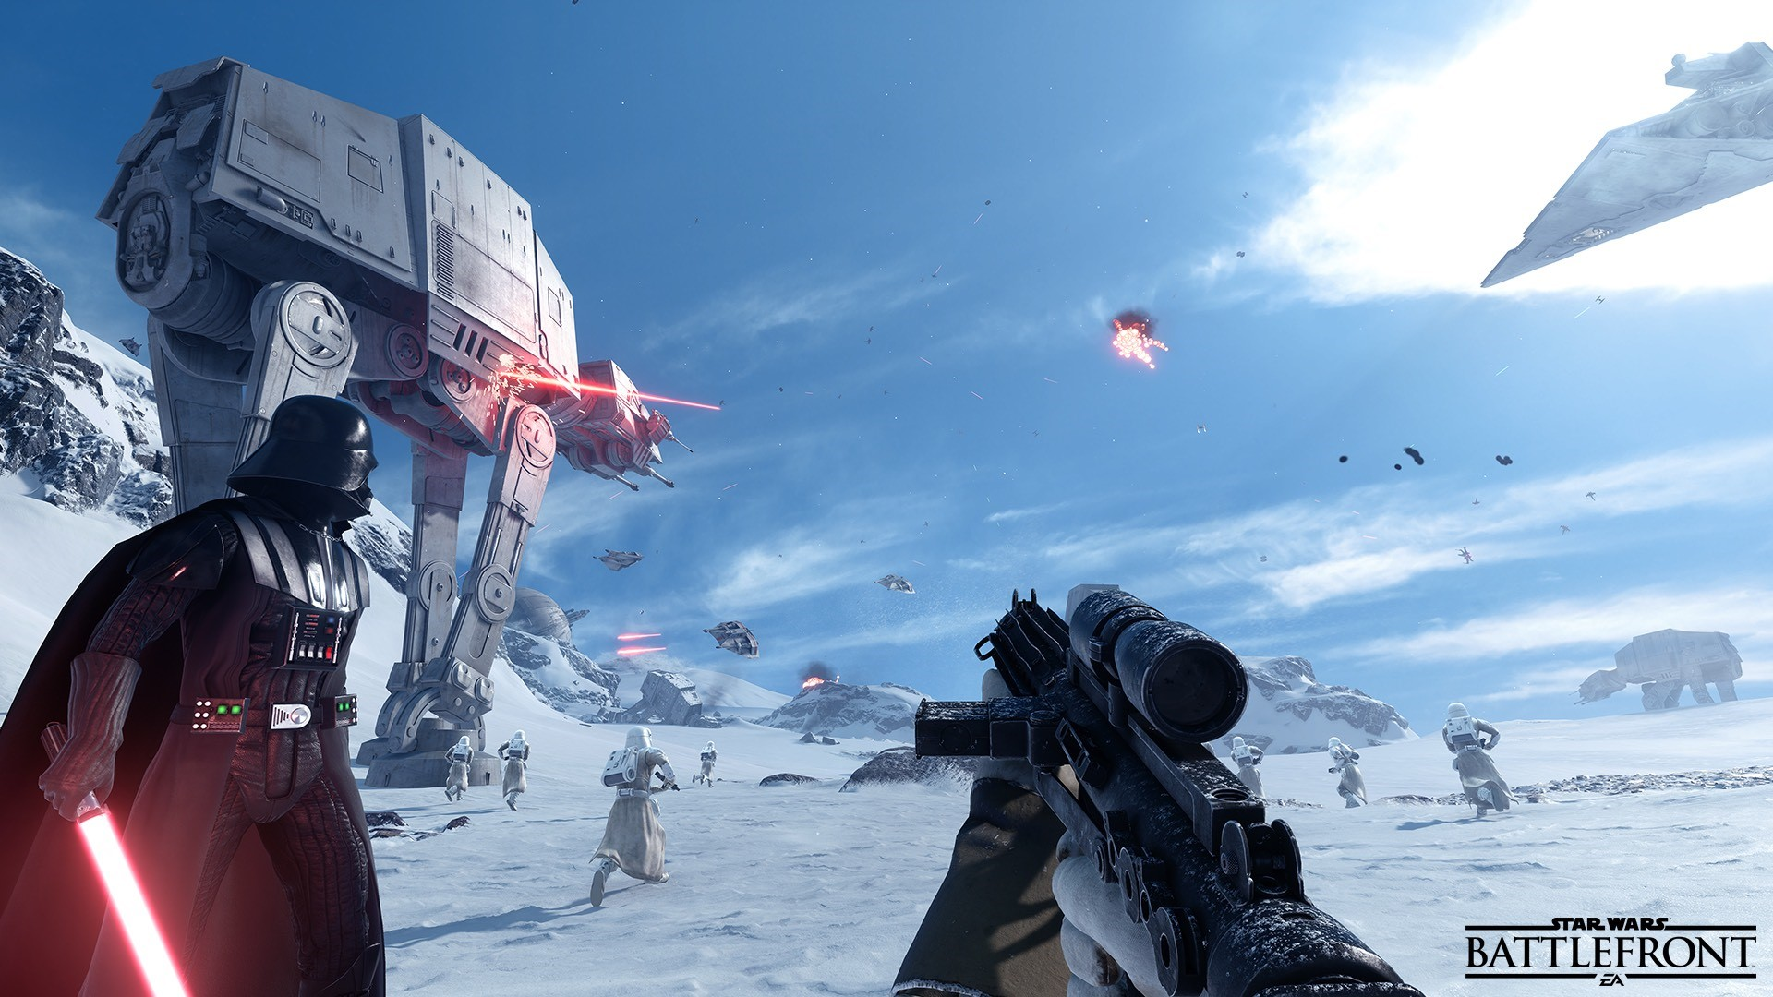
Introduction
Volumetric Cloud Rendering with Ray Marching
in Battlefield 4 and Star Wars Battlefront^{[EA]}

Slide 4

Ray Marching
Similar to ray tracing
Interact with volume
Only primary ray
Steps:
Ray Casting
Sampling
Shading
Composition

Slide 5
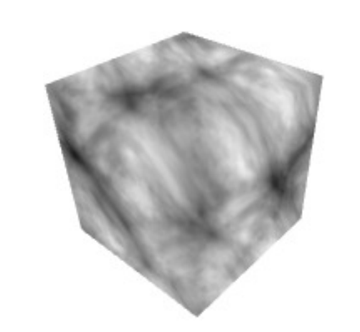
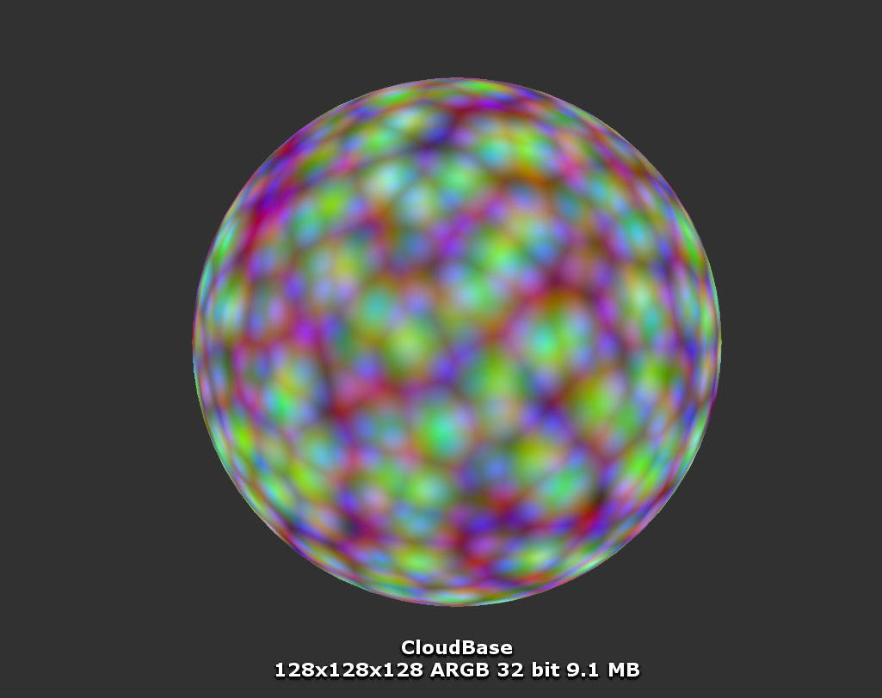
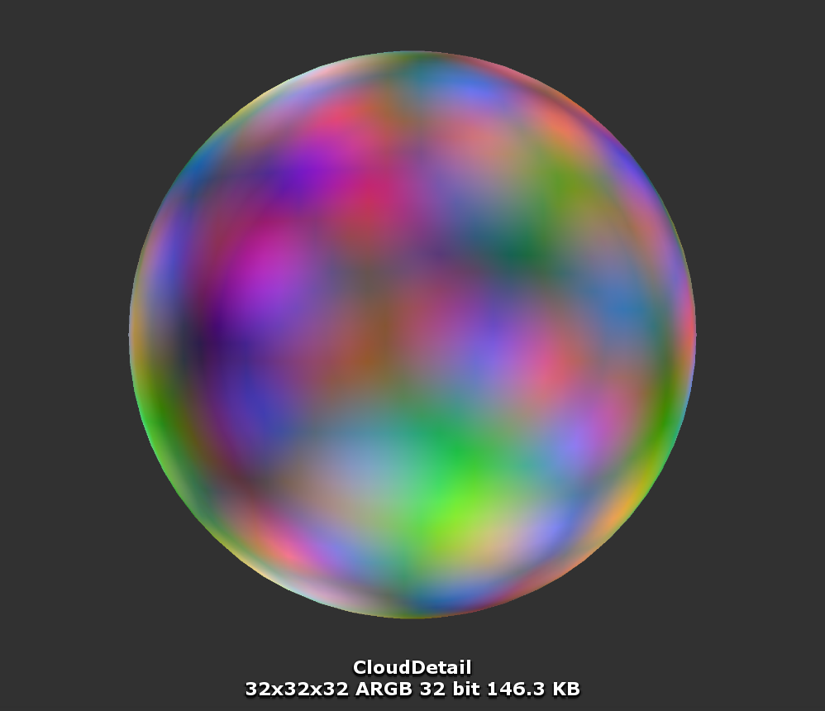
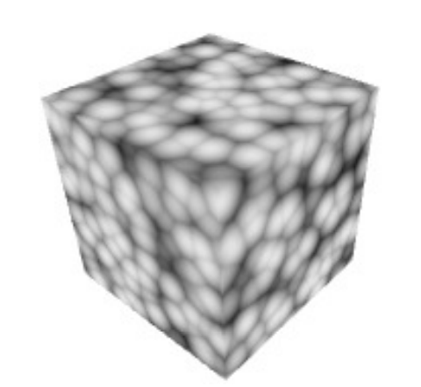
Cloud Shape
Texture | Size | R | G | B | A
Shape | 128*128*128 | Perlin | Worley | Worley | Worley
Detail | 32*32*32 | Worley | Worley | Worley | -
3D Perlin Noise ^{[RURIK]}
3D Worley Noise ^{[RURIK]}
Shape Texture
Detail Texture
Notes:
Ray Marching is similar to ray tracing. We assume the atmosphere is around the earth, which is a donut-like shape having two layers. Between the layers are clouds. We find the intereset points with the atmosphere, sample the noise as its density. Then sample towards the sunlight to get its lighting.
http://publications.lib.chalmers.se/records/fulltext/241770/241770.pdf

Slide 6
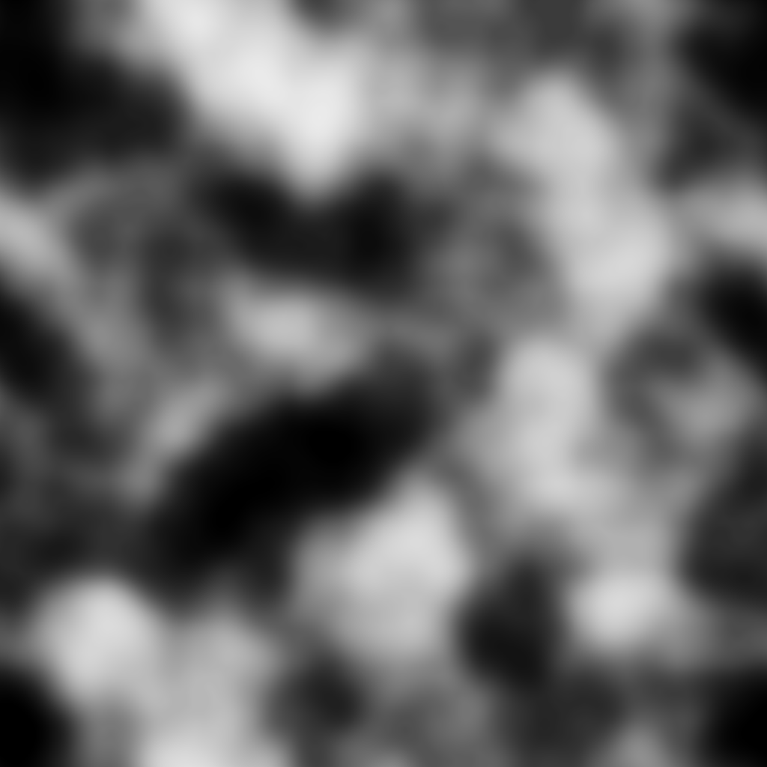
Cloud Shape
Basic Shape
Detail
(
-
) *
Shape =
Shape Texture
Detail Texture
Coverage Texture
Notes:
Ray Marching is similar to ray tracing. We assume the atmosphere is around the earth, which is a donut-like shape having two layers. Between the layers are clouds. We find the intereset points with the atmosphere, sample the noise as its density. Then sample towards the sunlight to get its lighting.
http://publications.lib.chalmers.se/records/fulltext/241770/241770.pdf

Slide 7
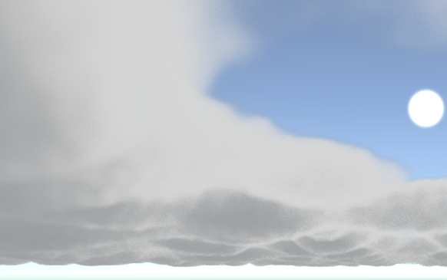
Lighting
What We Want:
Final Color = (ShadowColor + ShadowStrength + Scattering) *
Dark Edges * Transmittance
ShadowColor = Base color for the shadow part of the clouds
Scattering = pow(dot(rayDir, lightDir), ScatteringStrength);
Transmittance = Beer’s Law
Shadow Color

Slide 8
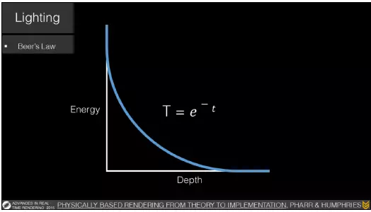
Lighting
Beer’s Law: Transmittance along with the distance ^{[GUERRILLA]}
Notes:
Attenuation

Slide 9
Lighting
What We Want:
Final Color = (ShadowColor + ShadowStrength + Scattering) *
Dark Edges * Transmittance
ShadowColor = Base color for the shadow part of the clouds
Scattering = pow(dot(rayDir, lightDir), ScatteringStrength);
Transmittance = Beer’s Law
Dark Edges = Powder Effect
Shadow Color
Notes:
The bigger it is, it will become more white color

Slide 10
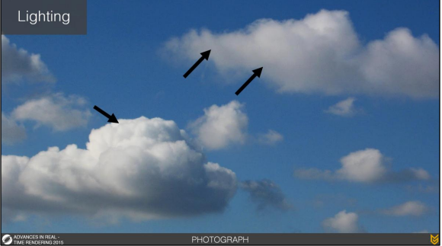
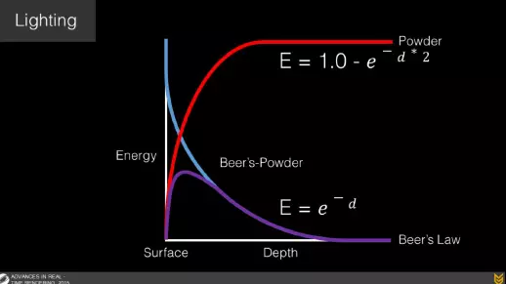
Lighting
Dark Edge ^{[GUERRILLA]}
Powder Effect ^{[GUERRILLA]}
Notes:
Power * beer’s :The energy of light will increase first then decrease. The bottom will have natural looking dark edges

Slide 11
Lighting
What We Want:
Final Color = (ShadowColor + ShadowStrength + Scattering) *
Dark Edges * Transmittance
ShadowColor = Base color for the shadow part of the clouds
Scattering = pow(dot(rayDir, lightDir), ScatteringStrength);
Transmittance = Beer’s Law
Dark Edges = Powder Effect
ShadowStrength = Sample towards sunlight
Shadow Color

Slide 12
Rendering
Steps:
Get density1 of A from sampling the shape texture along camera ray
Get density2 of B from sampling the shape texture along shadow ray
Use the difference (density1 – density2) to represent the shadow strength
How to get the sample UV?
Use ray marching, find the intersection points of the ray, sample along the ray in the atmosphere.
B
A

Slide 13
Rendering
Remember that it’s a donut-like atmosphere, we only do our ray marching above the horizon. Then we blend the result to the skybox.
Horizon

Slide 14
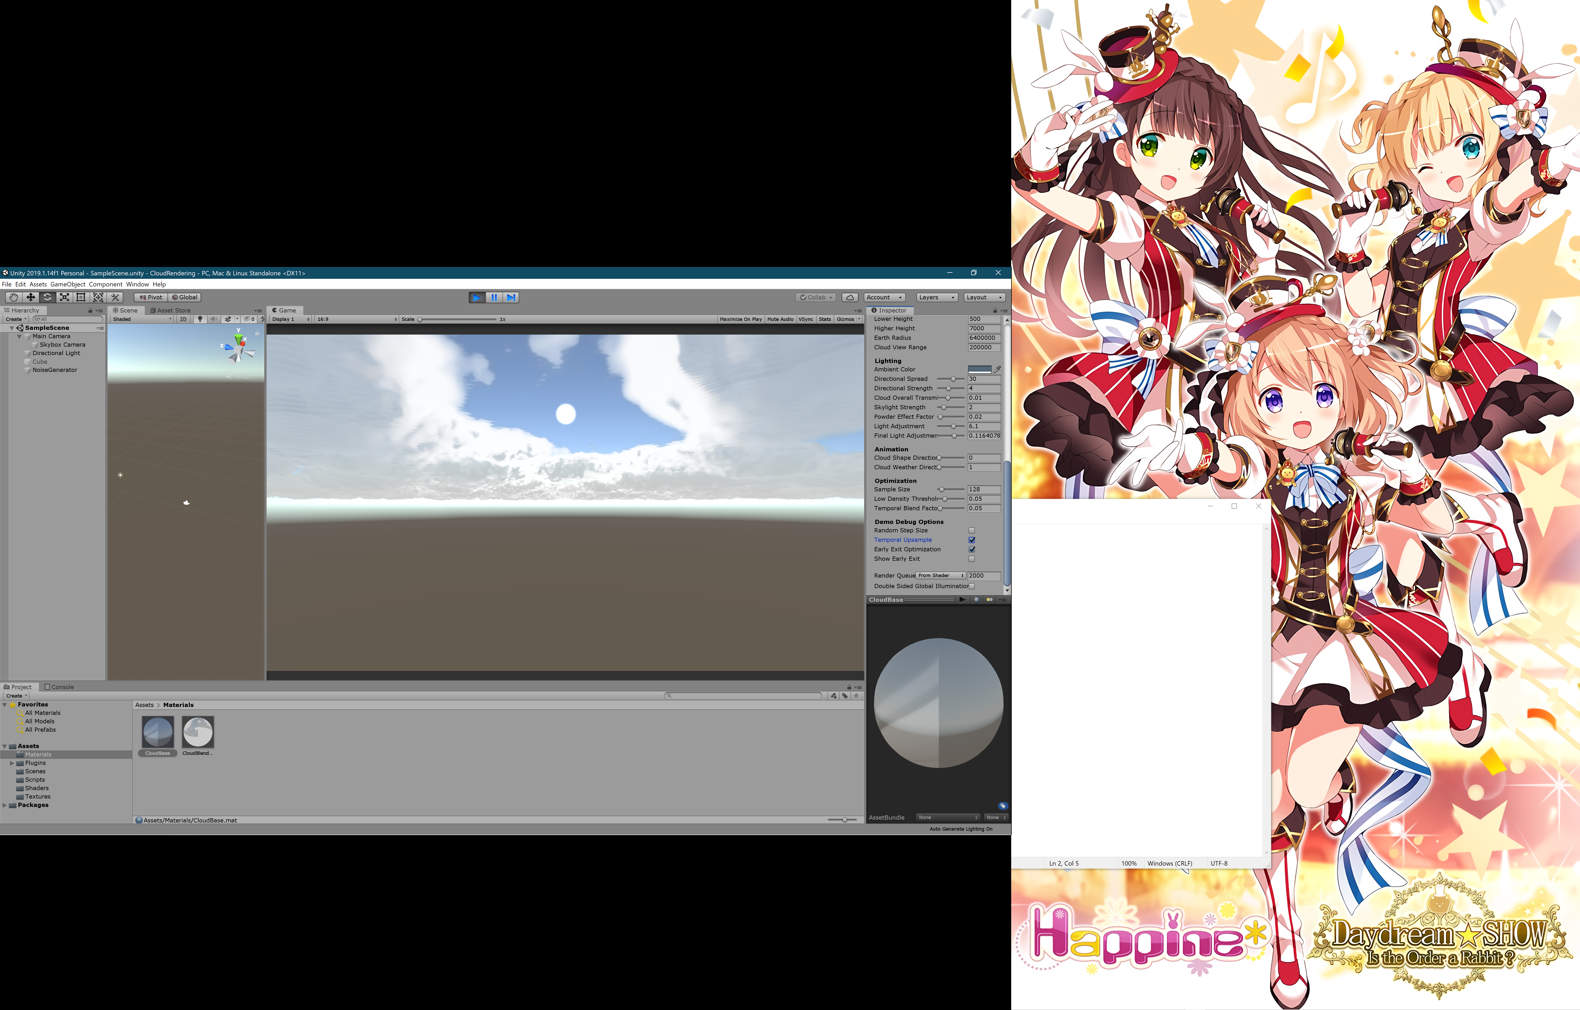


Temporal Upsampling
Banding issue
Randomized Ray Marching Step Size
Noise issue
Temporal Blending
Blend the current frame with last frame

Slide 15
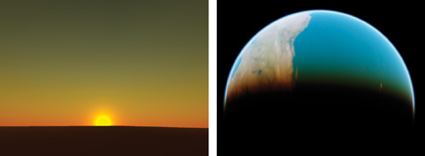
Atmosphere Scattering
GPU Gems 2 – Chapter 16 ^{[NVIDIA]}

Slide 16
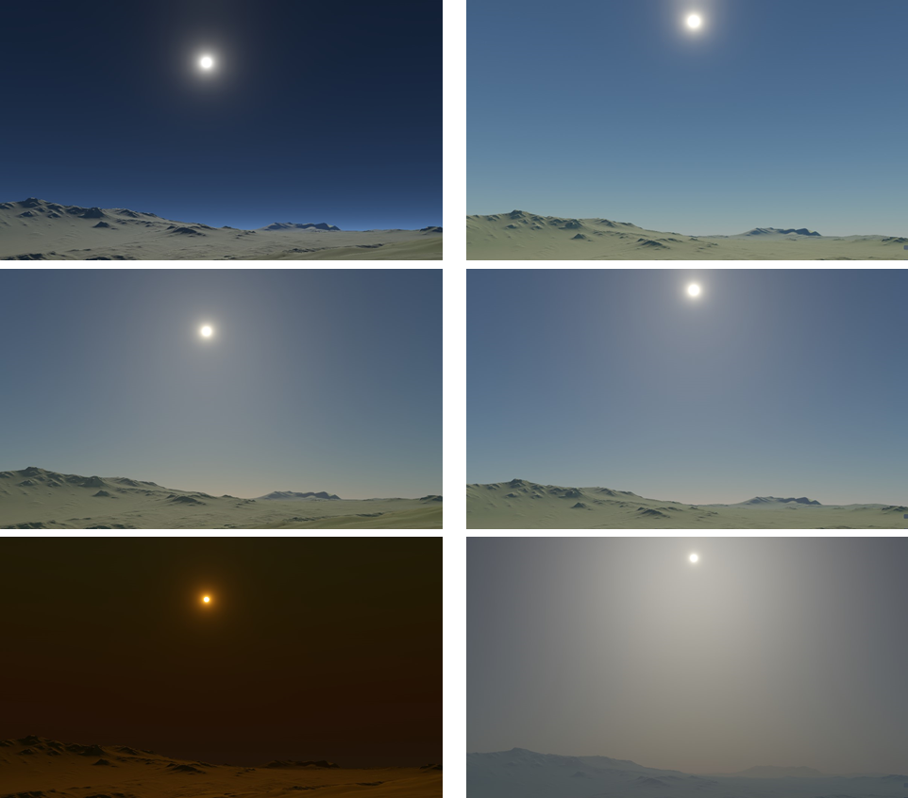
Atmosphere Scattering
Rayleigh Scattering
Mie Scattering
None
Mid
Heavy
Rayleigh
Mie
Sky Color with Rayleigh and Mie Scattering^{[EA]}

Slide 17


Atmosphere Scattering
Rayleigh Scattering
Mie Scattering
Phase Function
Out-Scattering Equation
In-Scattering Equation
$$F\left(θ,g\right)=\frac{3×\left(1−g^{2}\right)}{2×\left(2+g^{2}\right)}×\frac{1+\cos^{2}{θ}}{{\left(1+g^{2}−2⋅g⋅\cos{θ}\right)}^{\frac{3}{2}}}$$
$$t\left(P_{a}P_{b},λ\right)=4π×K\left(λ\right)×\int_{P_{a}}^{P_{b}}{\exp{−\frac{h}{H_{0}}}ds}$$
$$I_{v}\left(λ\right)=I_{s}\left(λ\right)×K\left(λ\right)×F\left(θ,g\right)×\int_{P_{a}}^{P_{b}}{\left(\exp{−\frac{h}{H_{0}}}×\exp\left(−t\left(PP_{c},λ\right)−t\left(PP_{a},λ\right)\right)\right)ds}$$

Slide 18
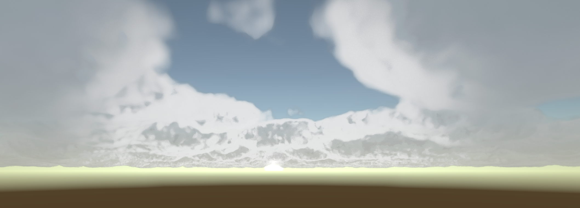
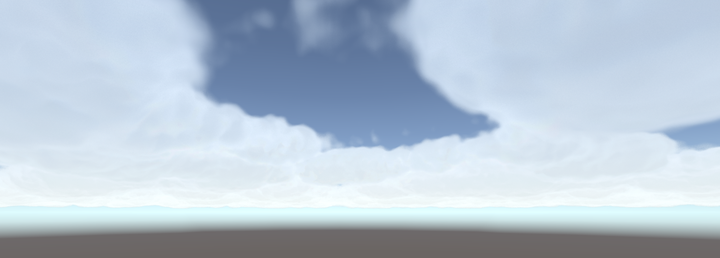
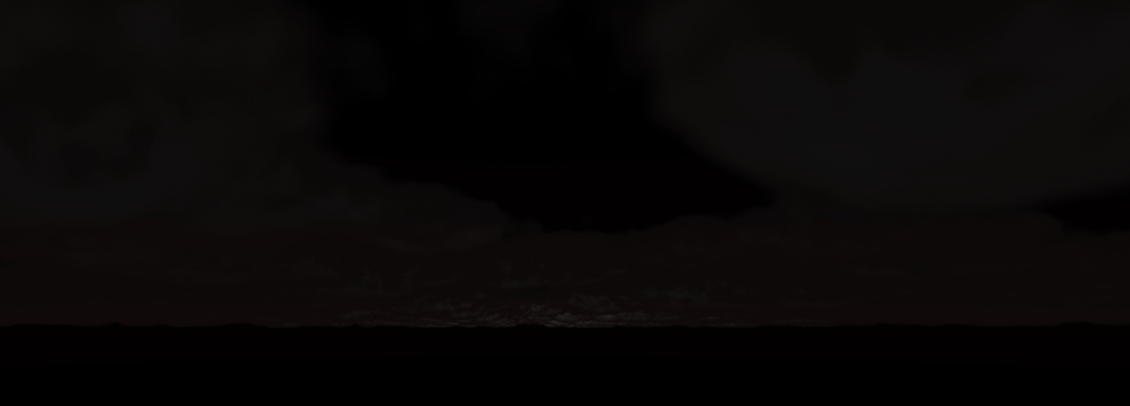
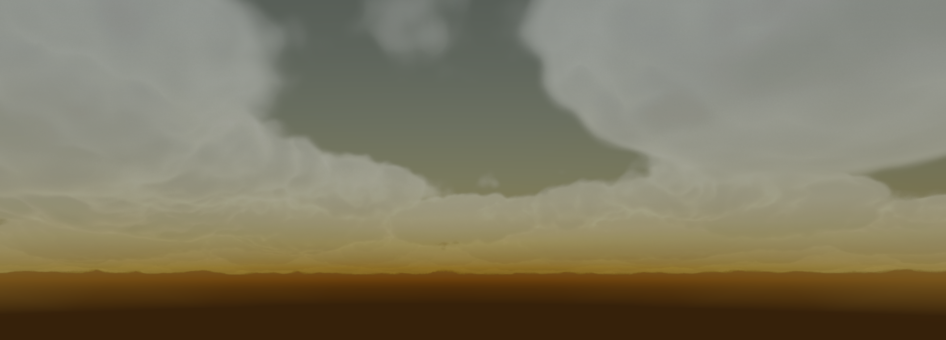
Atmosphere Scattering

Slide 19
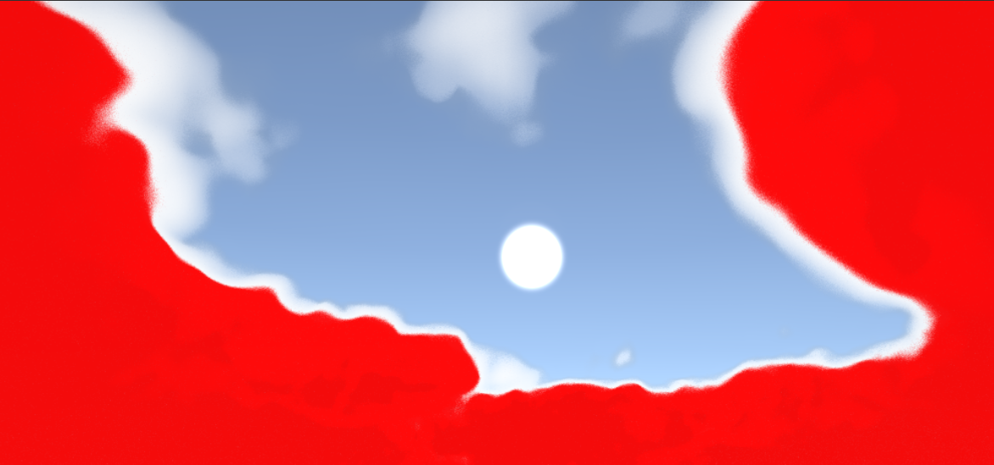
Optimizations
Temporal Upsampling
Early Exit

Slide 20
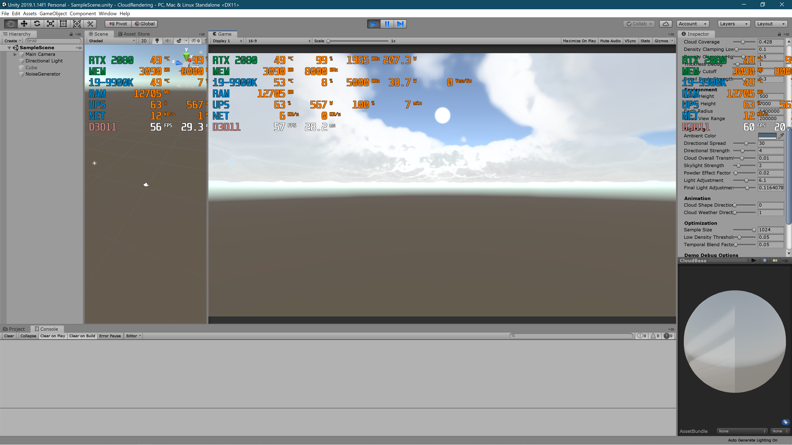
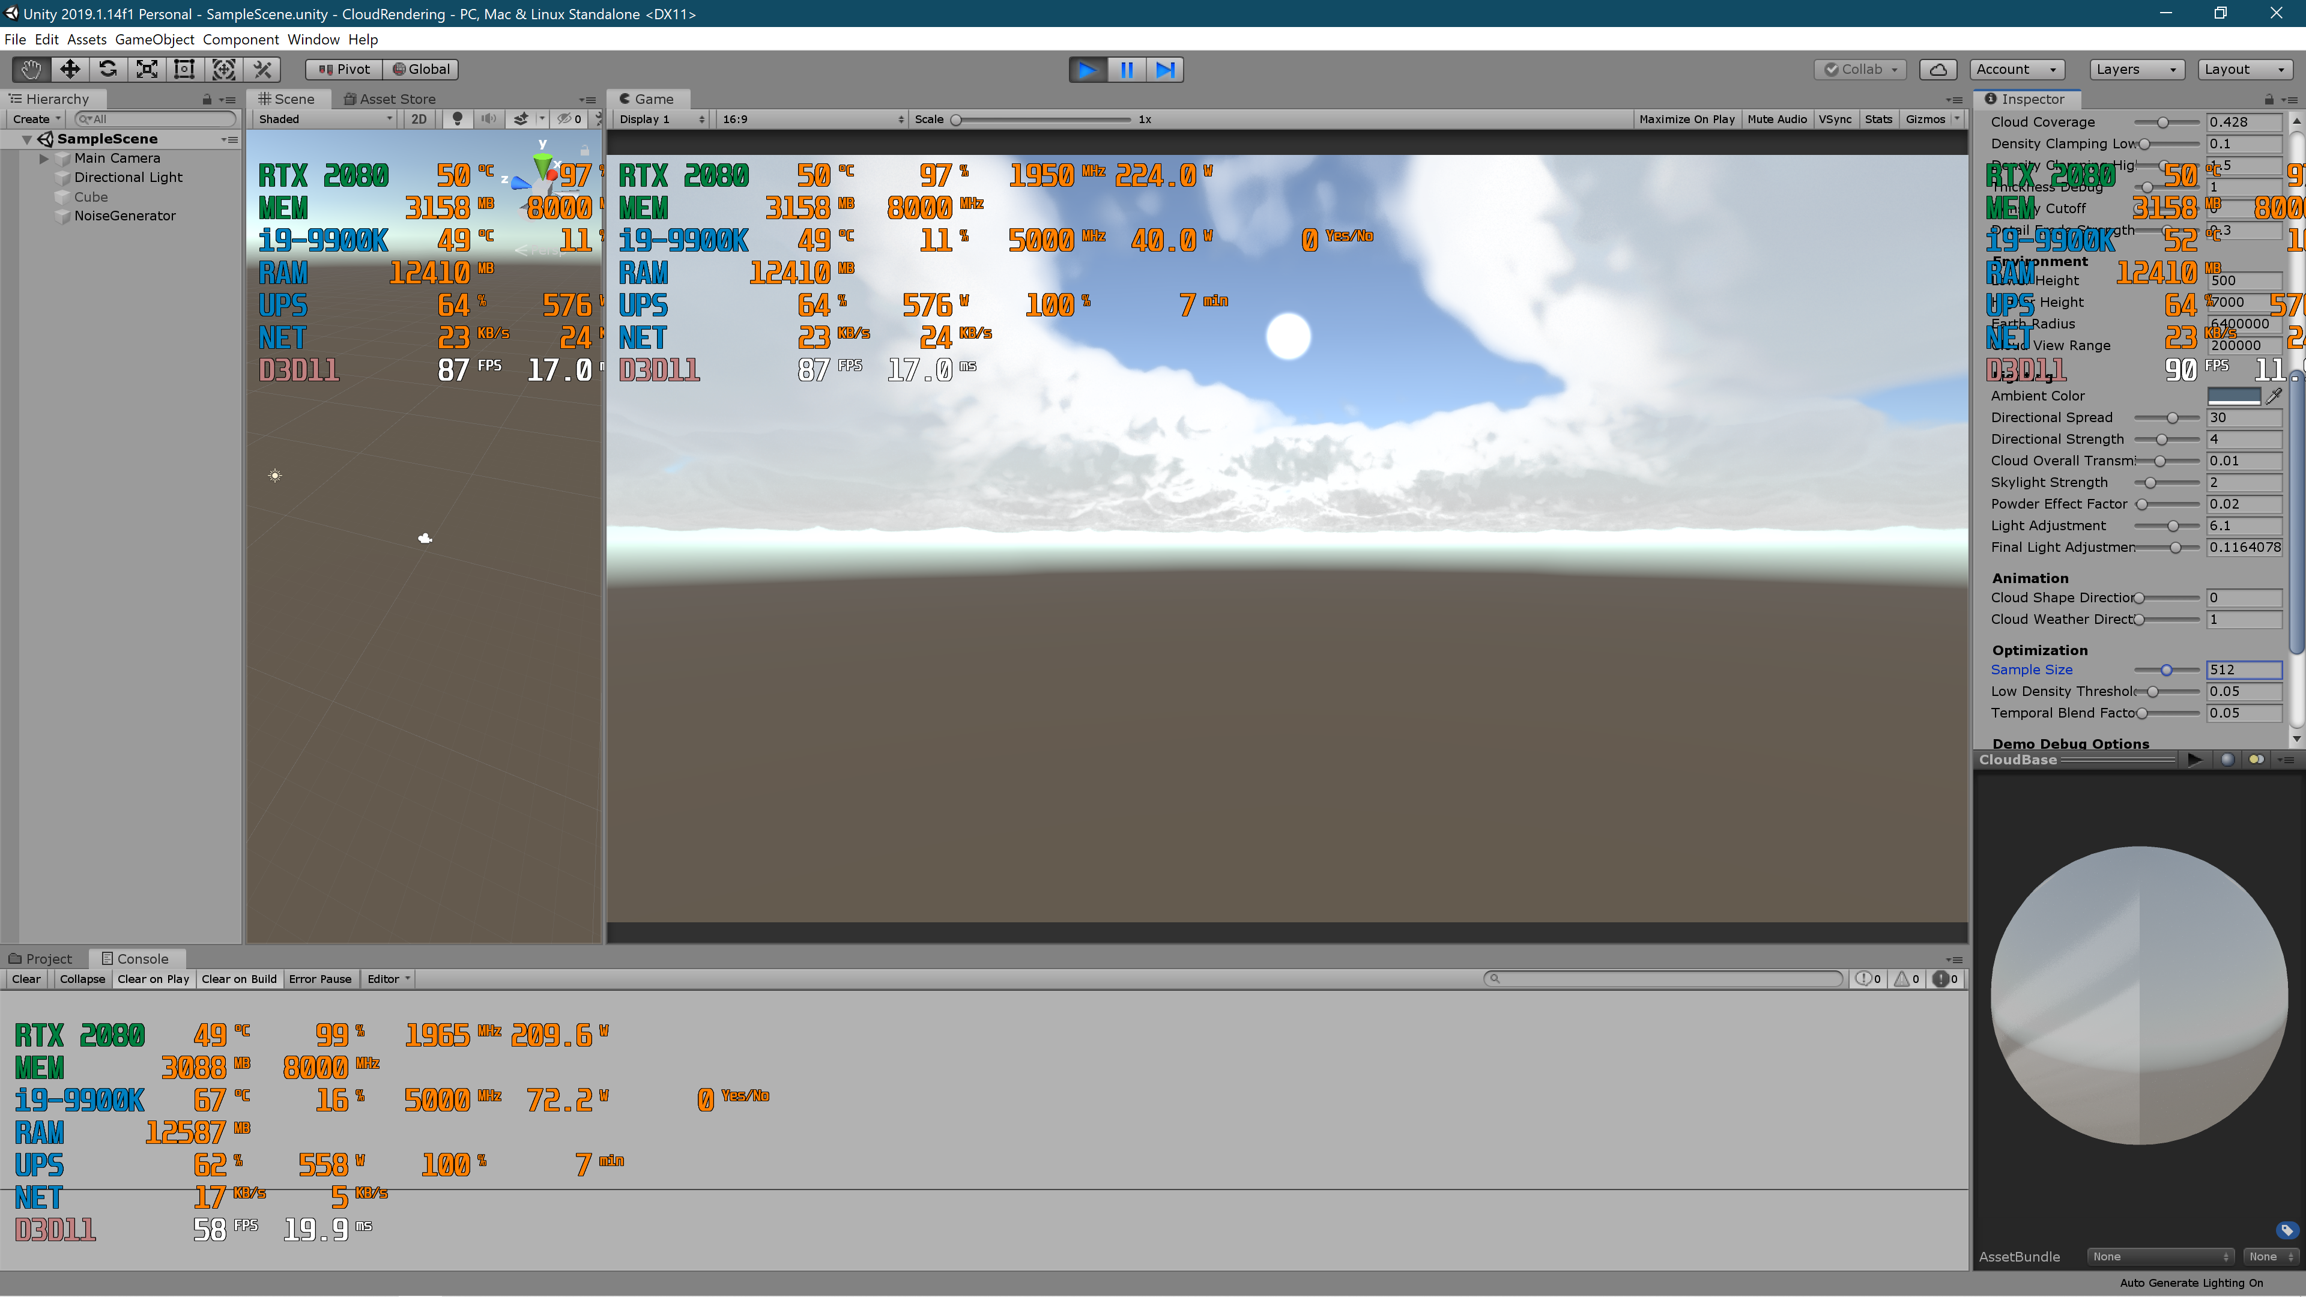
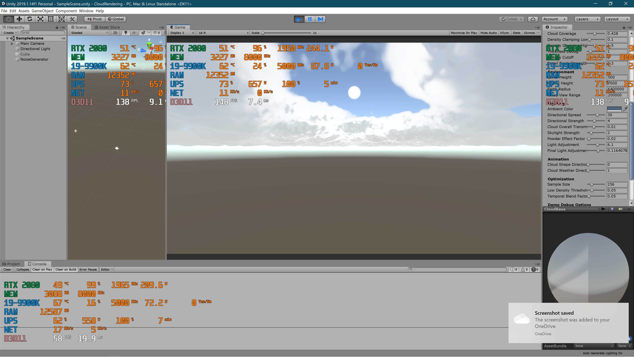
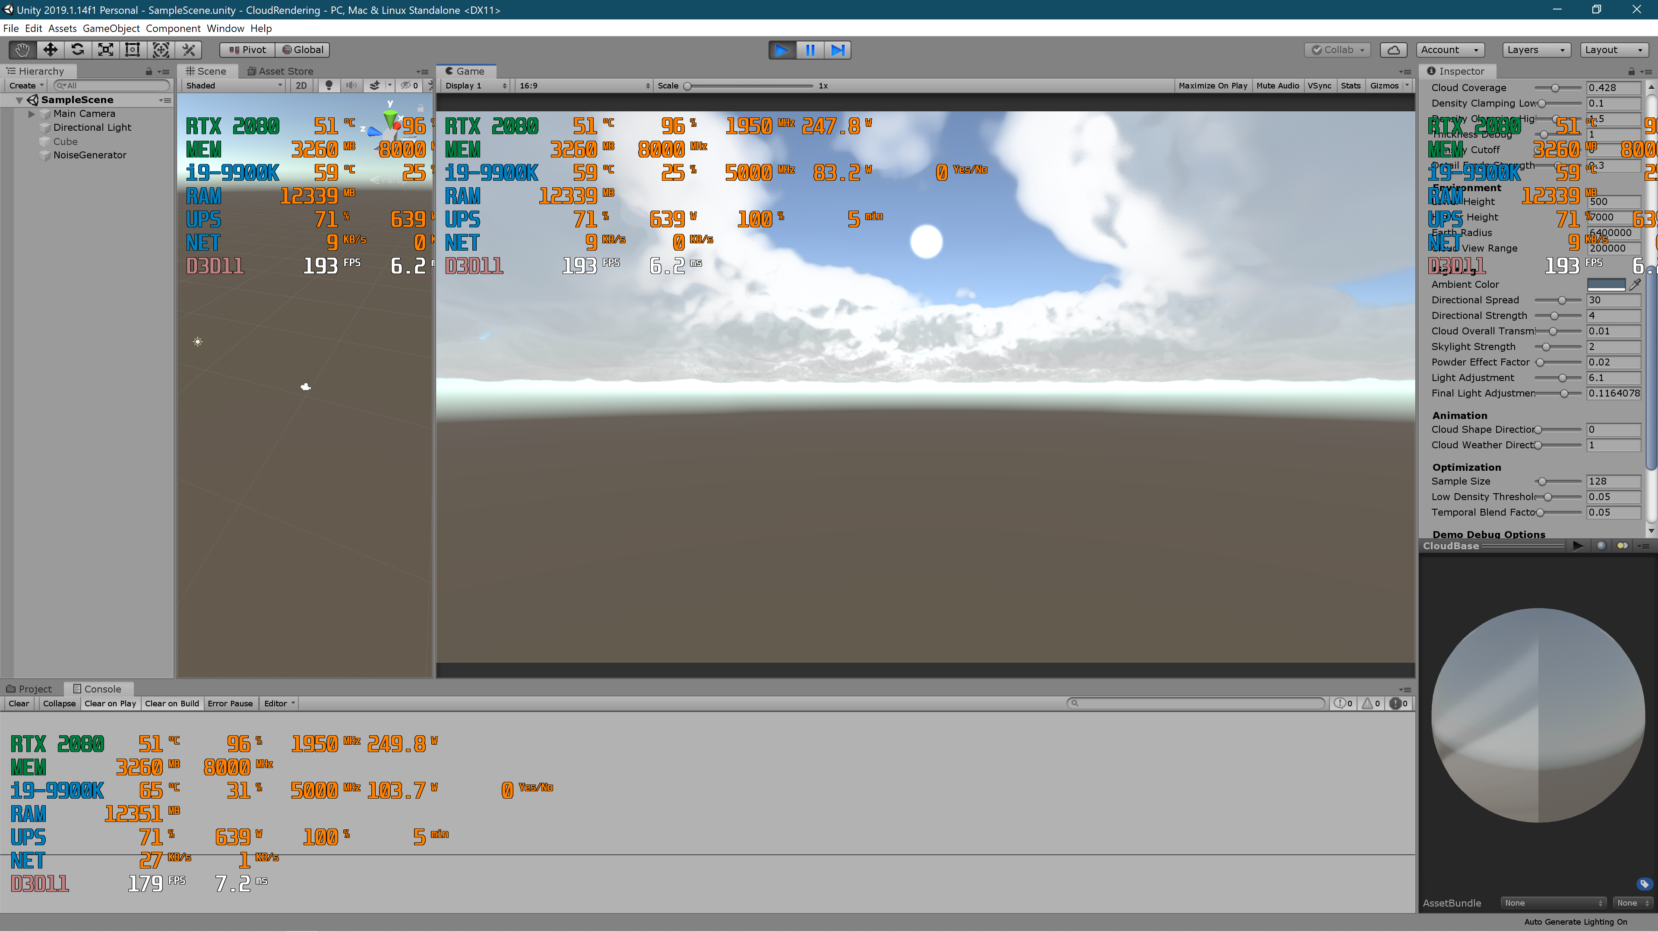
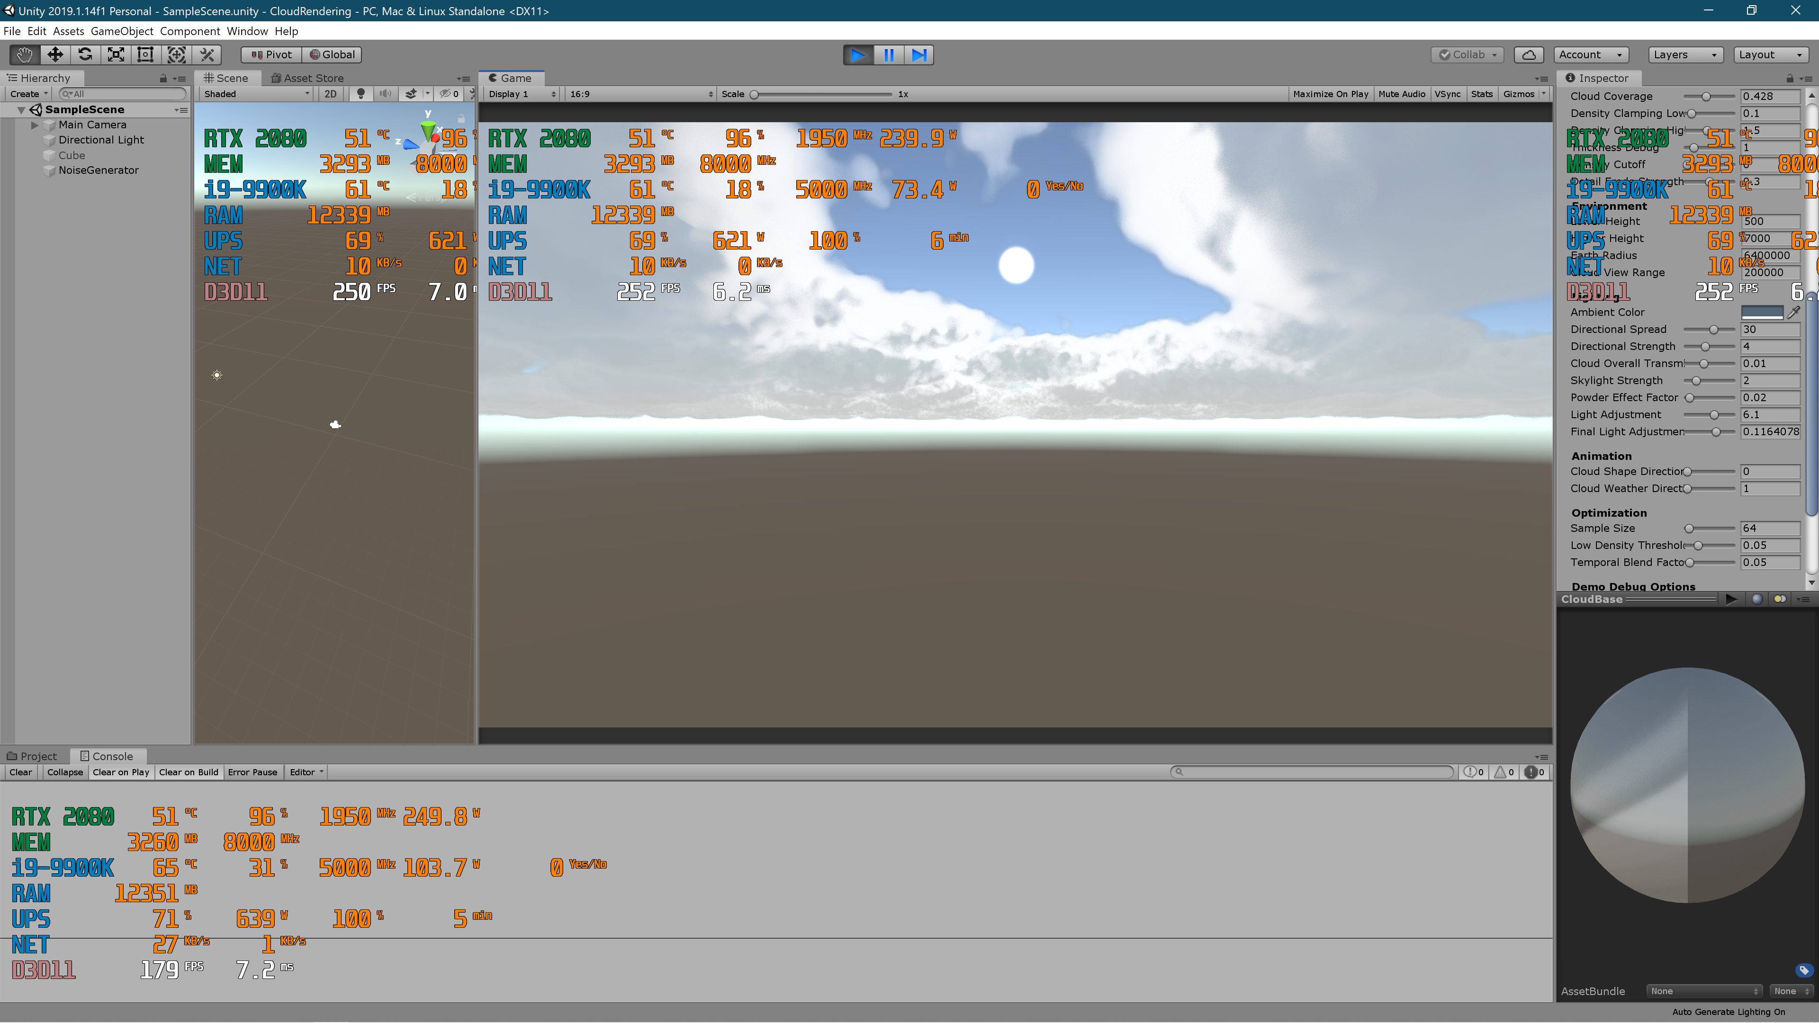

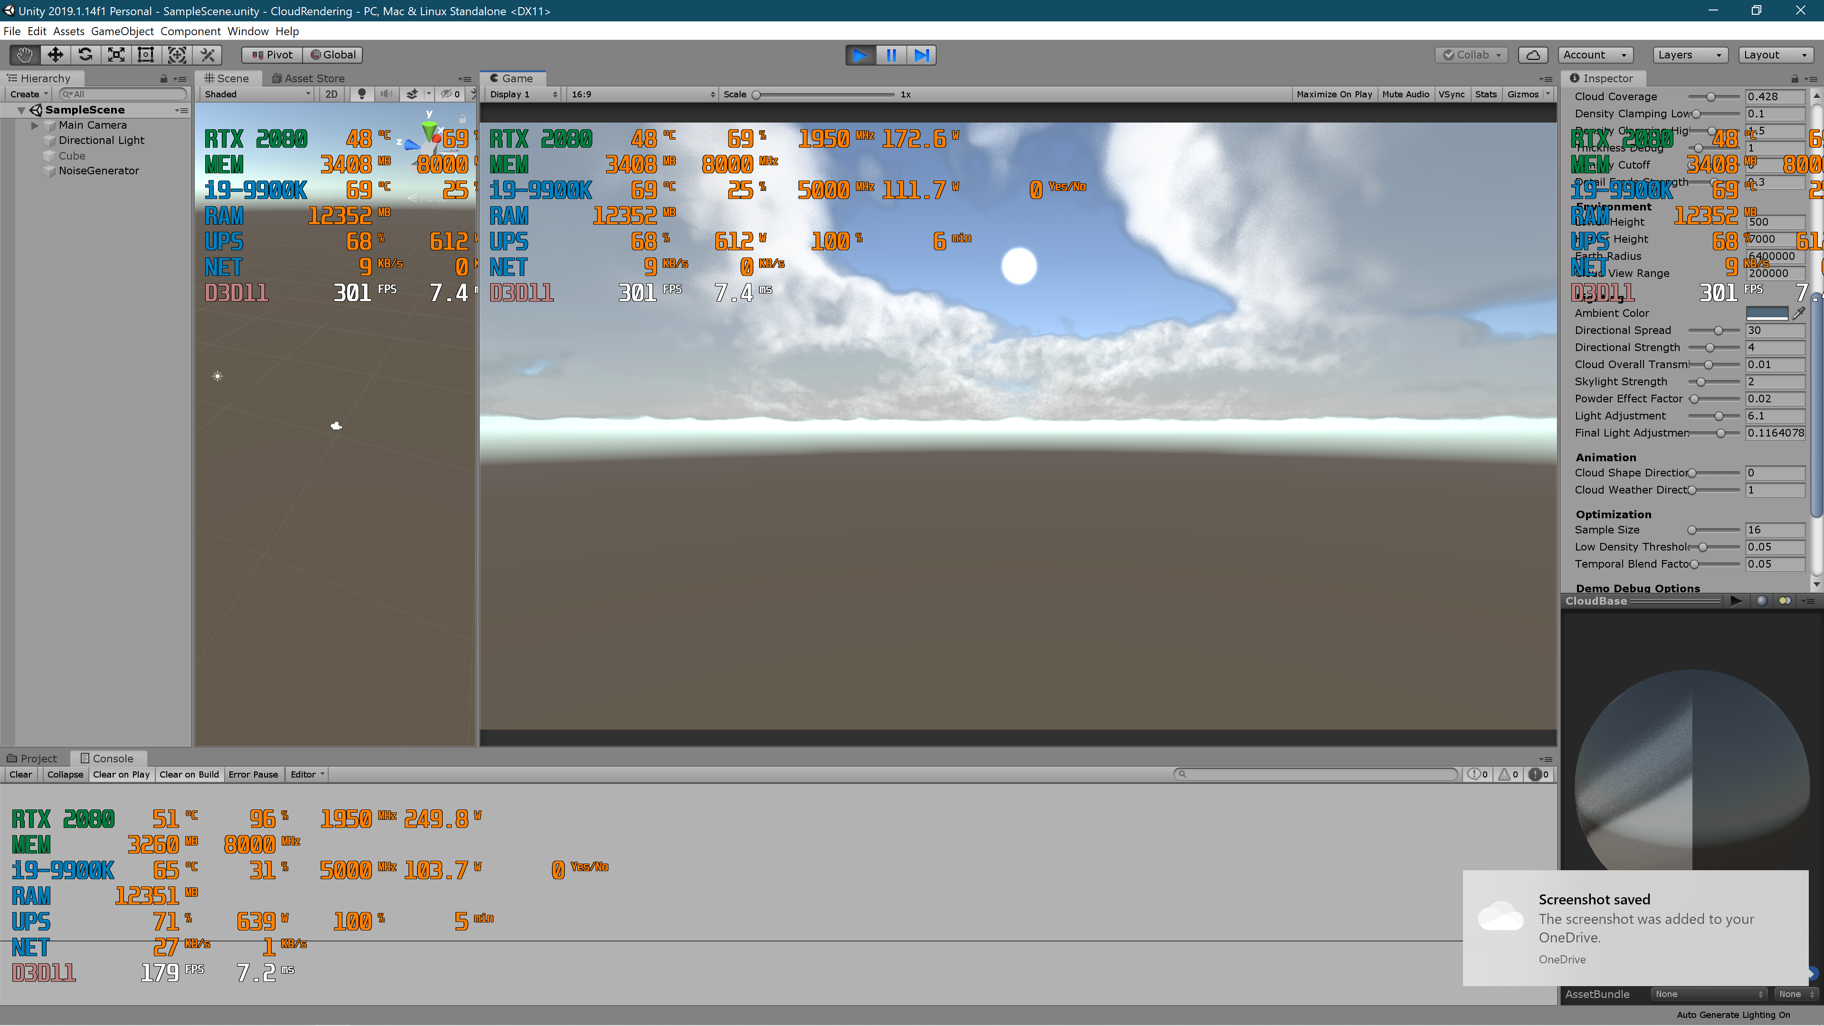
Results
1024
512
256
128
64
32
16

Slide 21
Results
1024
512
256
128
64
32
16

Slide 22
Results
1024
512
256
128
64
32
16

Slide 23
Results
1024
512
256
128
64
32
16

Slide 24
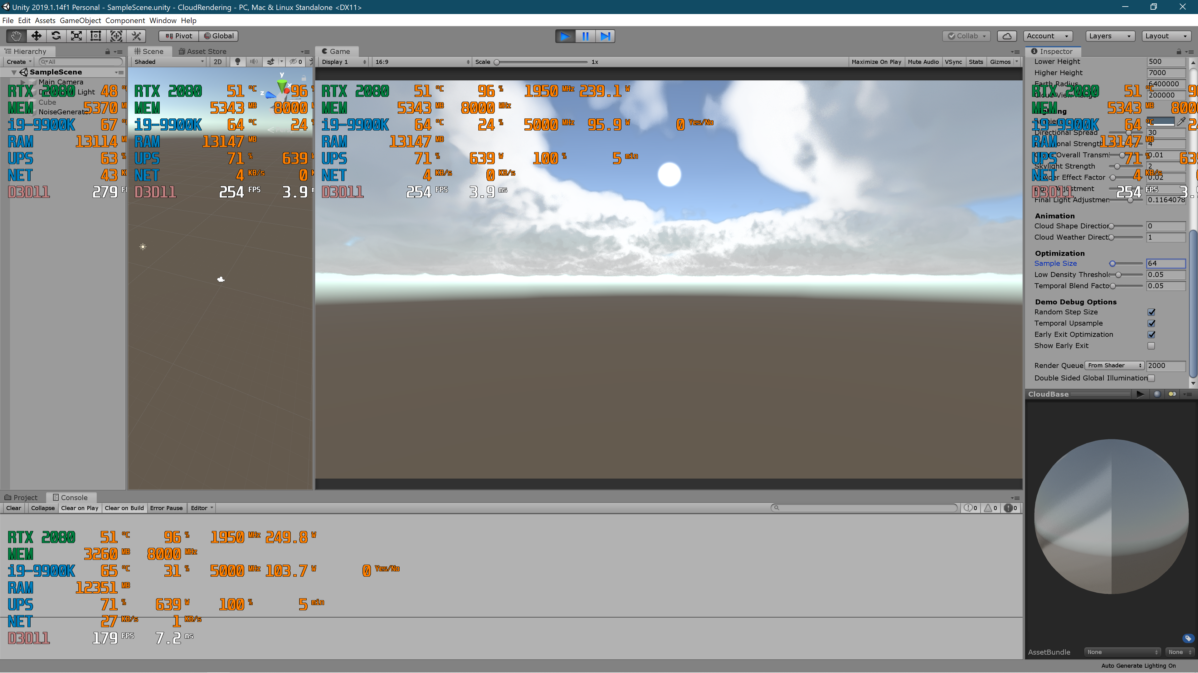
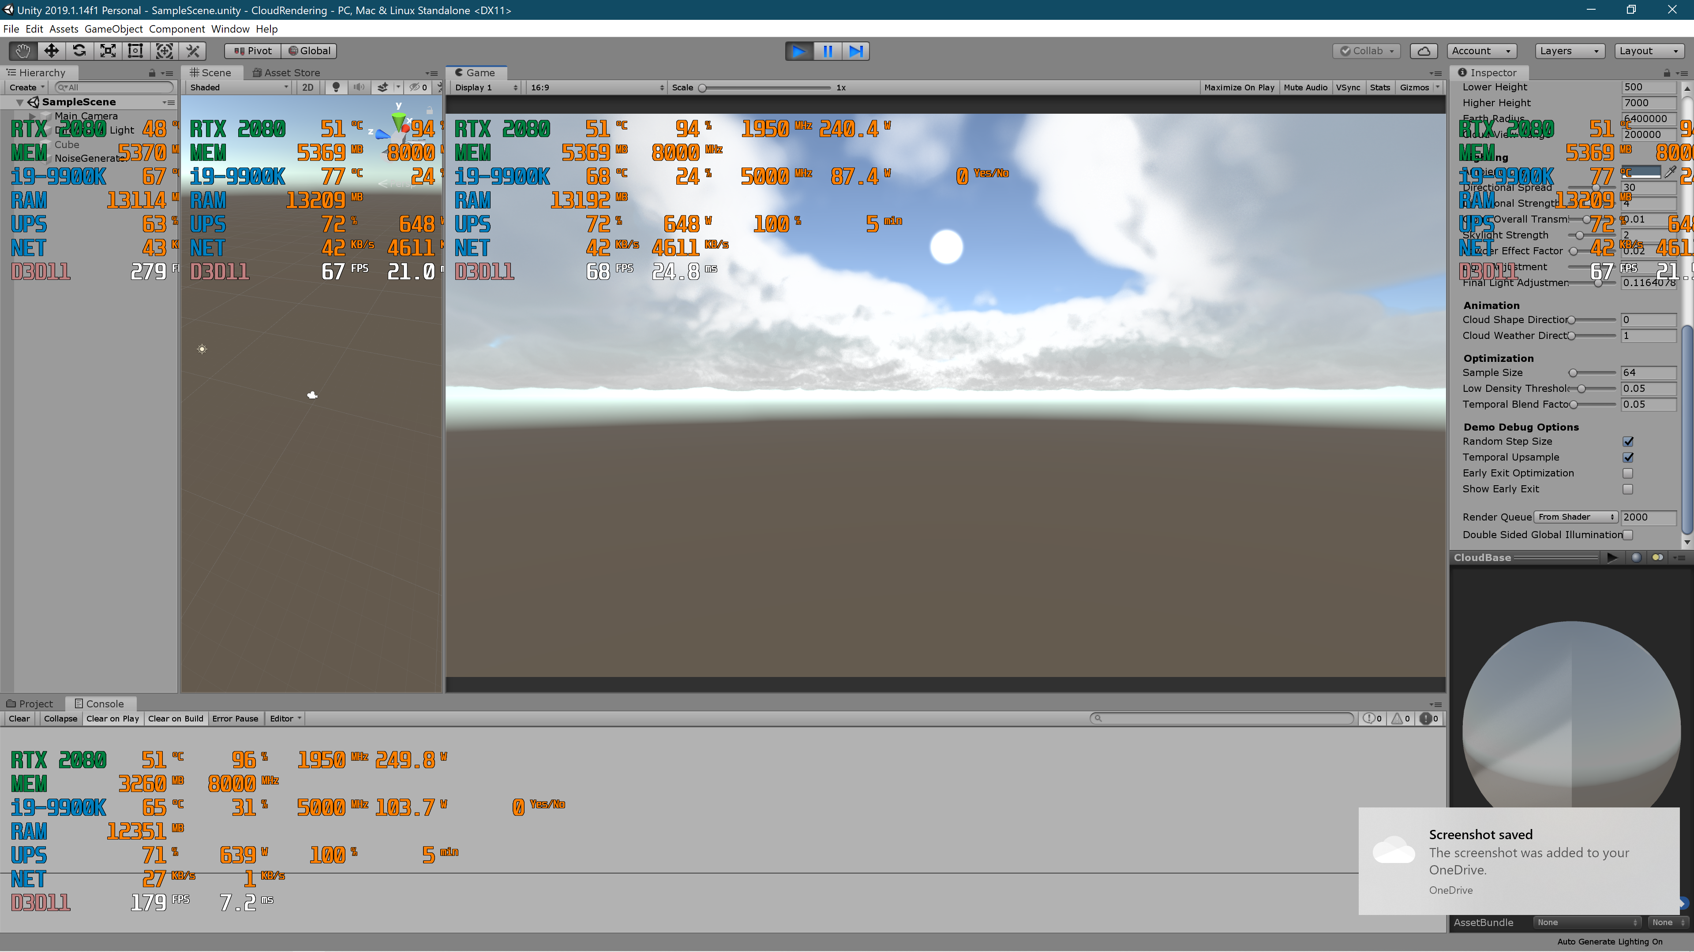
Results
With Early Exit
Without Early Exit

Slide 25
Results
With Early Exit
Without Early Exit

Slide 26
Results
With Early Exit
Without Early Exit

Slide 27
Contribution
Yun Jiang
Basic Cloud Rendering
Noise Generation
Ray Marching
Shading
Victor Shu
Enhancements
Temporal Upsampling
Atmospheric Scattering

Slide 28
References
The Art of The Witness – Clouds [WITNESS] http://www.artofluis.com/3d-work/the-art-of-the-witness/clouds/
The Real-Time Volumetric Cloudscapes of Horizon Zero Dawn [GUERRILLA] http://killzone.dl.playstation.net/killzone/horizonzerodawn/presentations/Siggraph15_Schneider_Real-Time_Volumetric_Cloudscapes_of_Horizon_Zero_Dawn.pdf
Physically Based Sky, Atmosphere and Cloud Rendering in Frostbite [EA] https://media.contentapi.ea.com/content/dam/eacom/frostbite/files/s2016-pbs-frostbite-sky-clouds-new.pdf
Convincing Cloud Rendering: An Implementation of Real-Time Dynamic Volumetric Clouds in Frostbite [RURIK] http://publications.lib.chalmers.se/records/fulltext/241770/241770.pdf
GPU Gems 2, Chapter 16: Accurate Atmospheric Scattering [NVIDIA] https://developer.nvidia.com/gpugems/GPUGems2/gpugems2_chapter16.html

Slide 29
DEMO

